Slide 1
Transkribus - a user’s perspective
Novi Sad/Belgrade, 2019-12-12/13
Peter Andorfer

Slide 2
who am I
researcher at the Austrian Centre for Digital Humanities of the Austrian Academy of Sciences (ACDH-OeAW)
user of Transkribus and not part of the Transkribus project
personal research projects
handwritten archival material 18th century (https://rita.acdh.oeaw.ac.at/l)
(technical) partner of different kind of research projects
collection of newspaper-slips (https://schnitzler-zeitungen.acdh-dev.oeaw.ac.at/)
archival material 20th century (https://gtrans.acdh.oeaw.ac.at/)
vienna land registries 15th century
…
developing Transkribus based applications
django-app to search/browse Transkribus collections https://github.com/acdh-oeaw/acdh-django-transkribus
acdh-prodigy-utils https://github.com/acdh-oeaw/acdh-prodigy-utils stream images/text from Transkribus into prodigy’s annotation interface (NER, textclassifaction)

Slide 3
what is Transkribus
mostly known for
(Handwritten) Text Recognition (HTR)

Slide 4
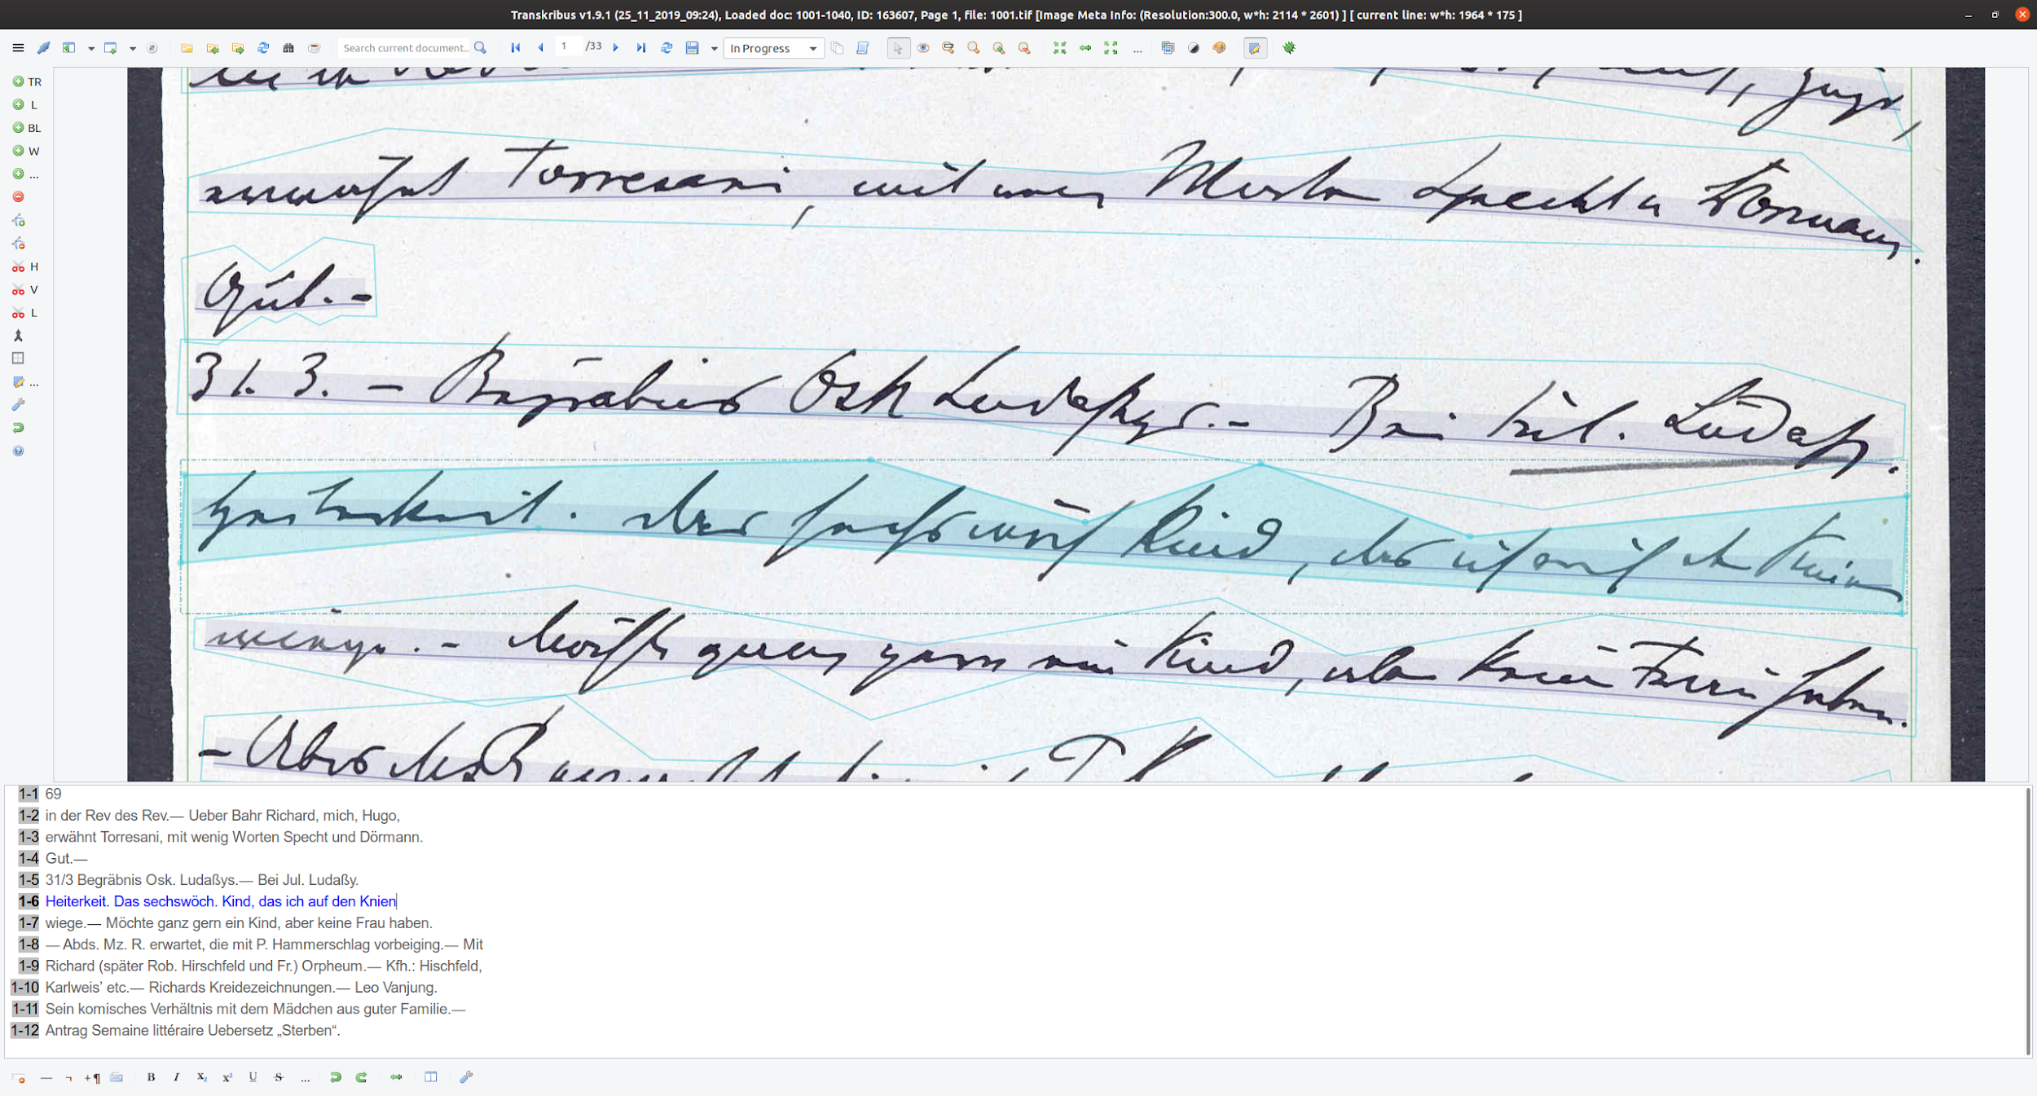
Arthur Schnitzler, Diary entry, 1895-03-31

Slide 5
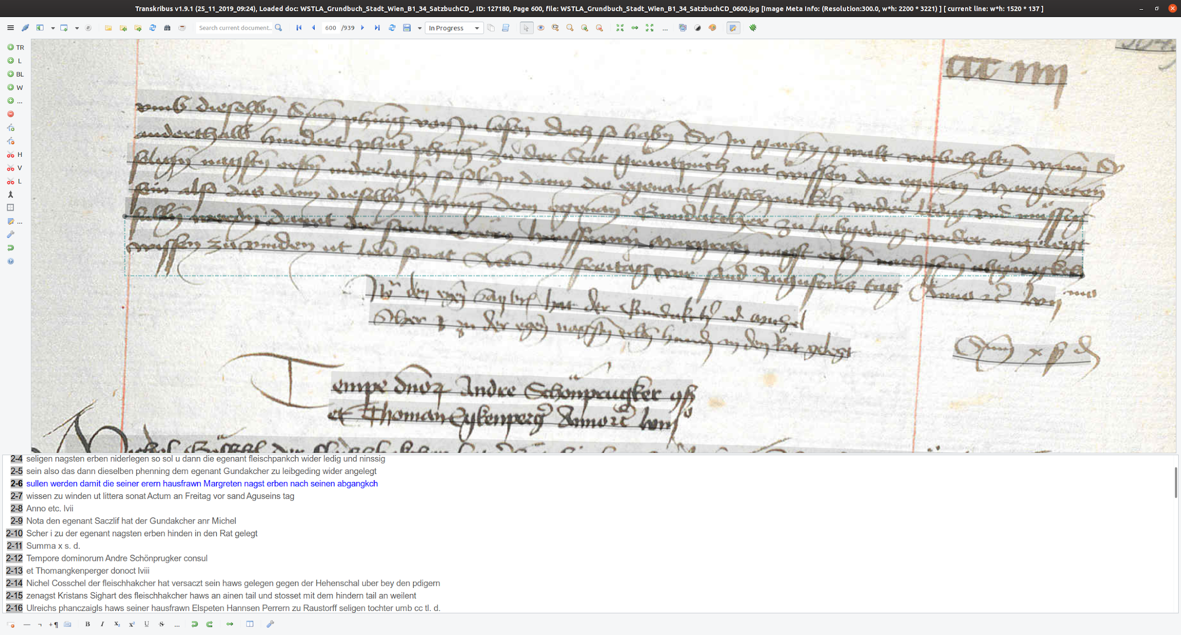
Land Registry, Vienna, 15th century

Slide 6
what is Transkribus
mostly known for
(Handwritten) Text Recogintion (HTR)
but (necessarily) performs
Layout Detection/Recognition

Slide 7
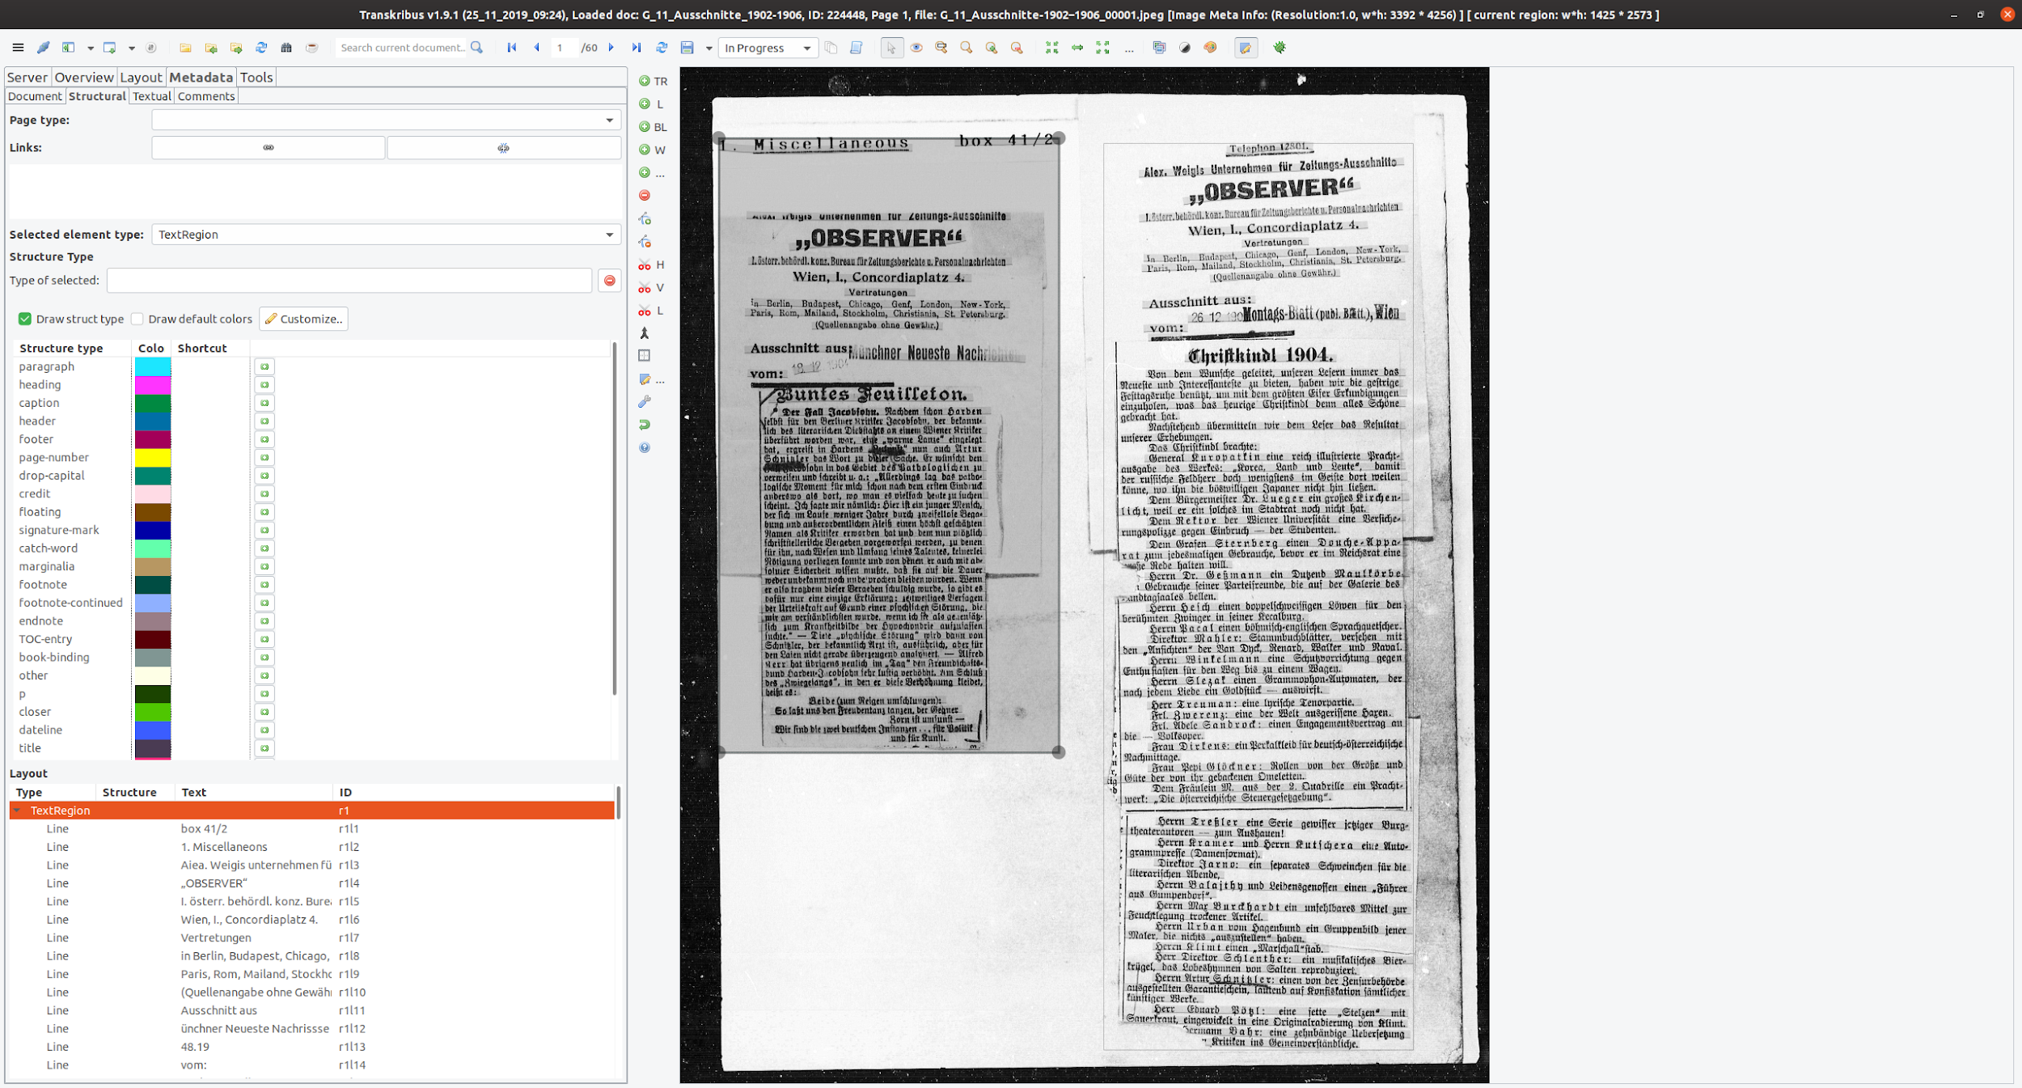
Collection of newspaper clips about Arthur Schnitzler

Slide 8
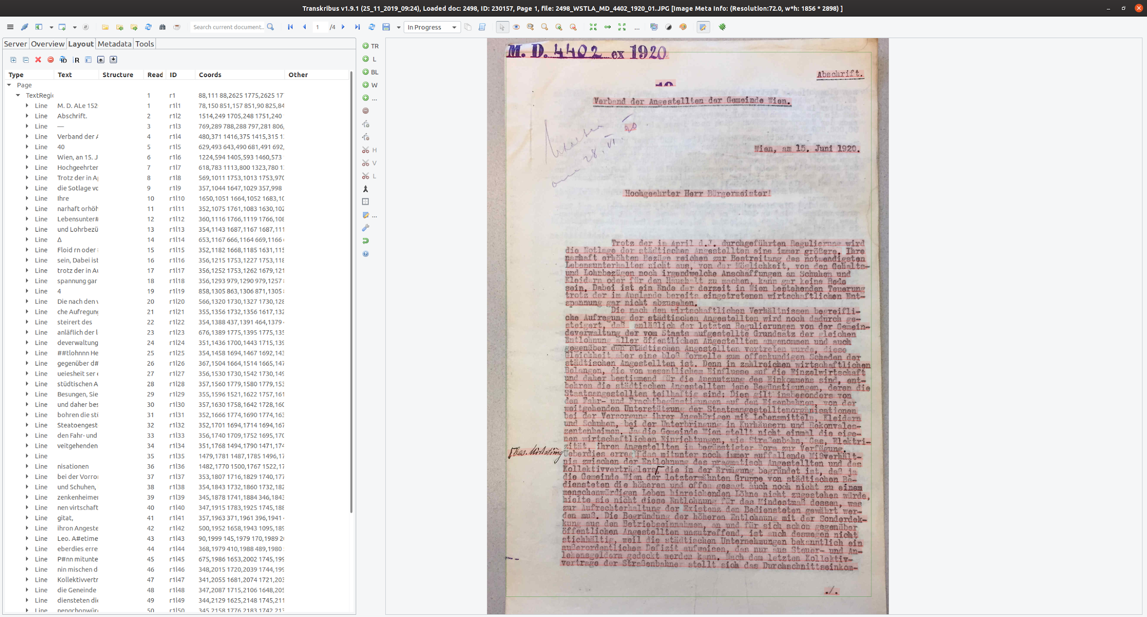
Archival Material, WStLA

Slide 9
what is Transkribus
mostly known for
(Handwritten) Text Recognition (HTR)
but (necessarily) performs
Layout Detection/Recognition
Layout Analysis (early state)

Slide 10
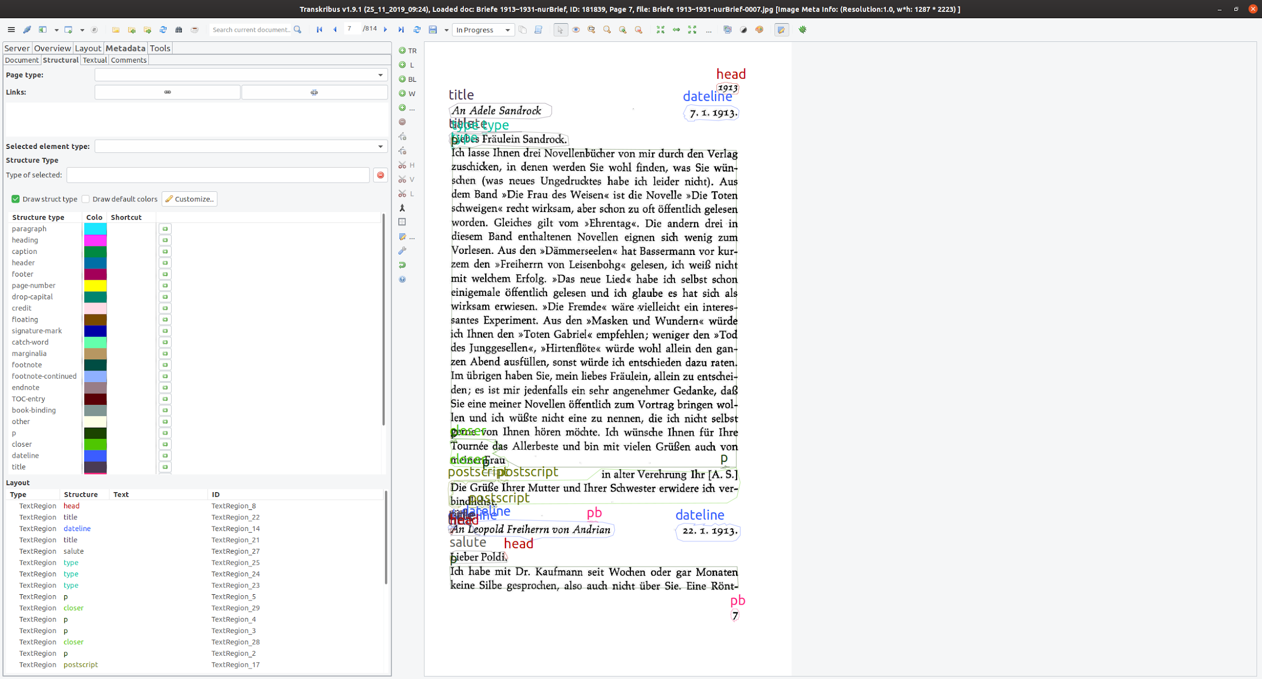
Edition of Letters from Arthur Schnitzler

Slide 11
what is Transkribus
mostly known for
(Handwritten) Text Recognition (HTR)
but (necessarily) performs
Layout Detection/Recognition
Layout Analysis (early state)
and provides storage/hosting
user management

Slide 12
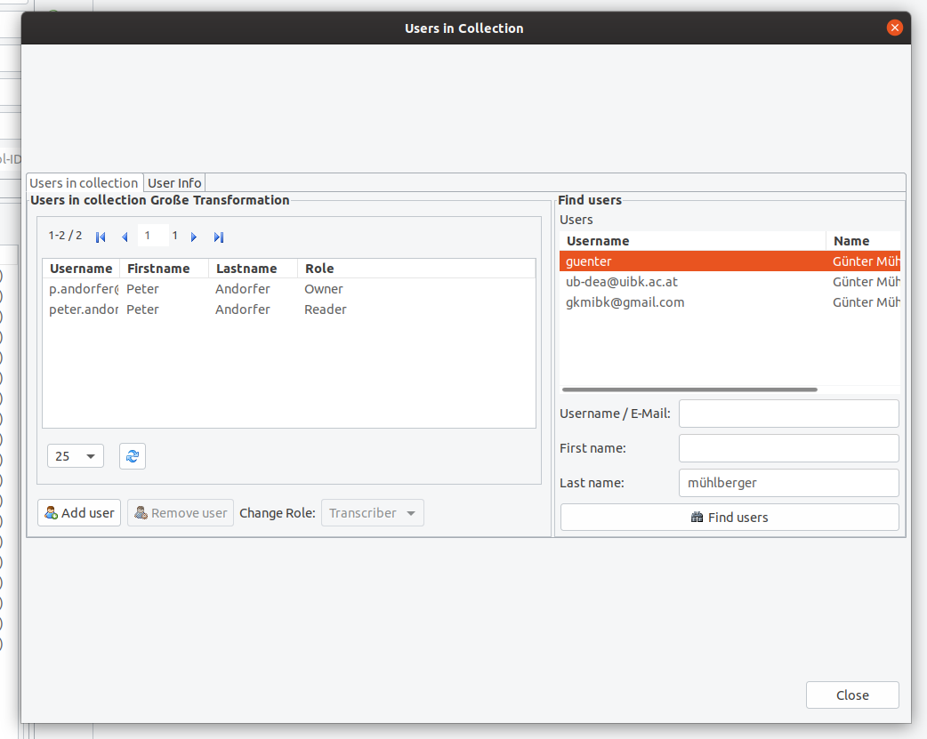
User Management Interface

Slide 13
what is Transkribus
mostly known for
(Handwritten) Text Recognition (HTR)
but (necessarily) performs
Layout Detection/Recognition
Layout Analysis (early state)
and provides storage/hosting/interfaces (‘Datenschleuder’ ‘data distributor’)
user management
API

Slide 14
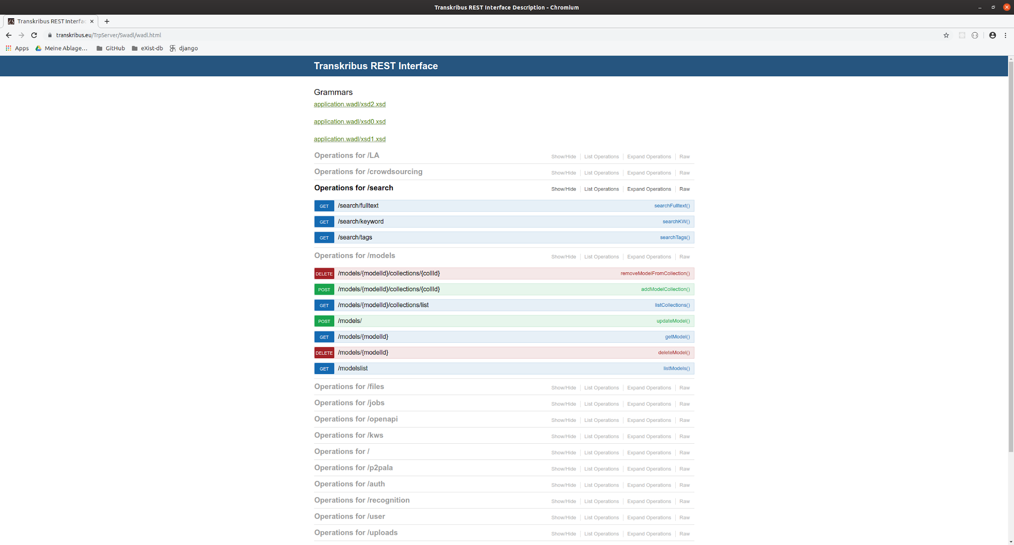
Transkribus API-Definition https://transkribus.eu/TrpServer/Swadl/wadl.html

Slide 15
what is Transkribus
mostly known for
(Handwritten) Text Recognition (HTR)
but (necessarily) performs
Layout Detection/Recognition
Layout Analysis (early state)
and provides storage/hosting/interfaces (‘Datenschleuder’ ‘data distributor’)
user management
API
many export formats

Slide 16
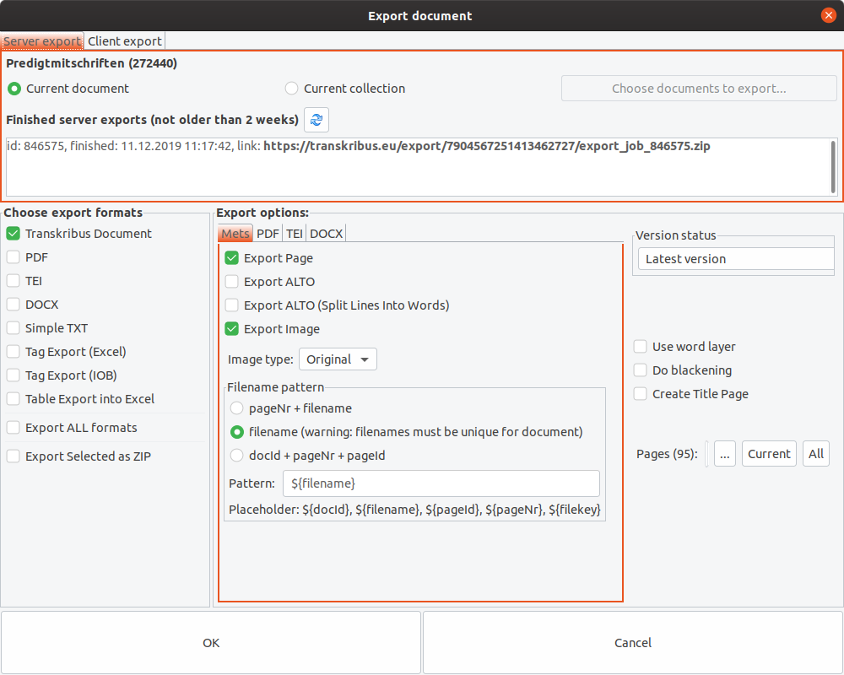
supported export formats

Slide 17
READ - Transkribus: Facts and figures
EU Horizon 2020 Project, coordinated by Digitisation and Digital Preservation group University Innsbruck
8,2 mill. EUR funding
Duration: 1.1.2016 – 30.6.2019
14 partners, 75 Memorandum of Understandings
Final review in Luxembourg, 12th September 2019: Reviewers voted for “Excellent”

Slide 18
READ - Transkribus: Focus
Research: 60% - Pattern Recognition, Machine Learning, Computer Vision,…
Network building: 20% - Scientific competitions, workshops, support,…
Service: 20% - Set up of a service platform

Slide 19
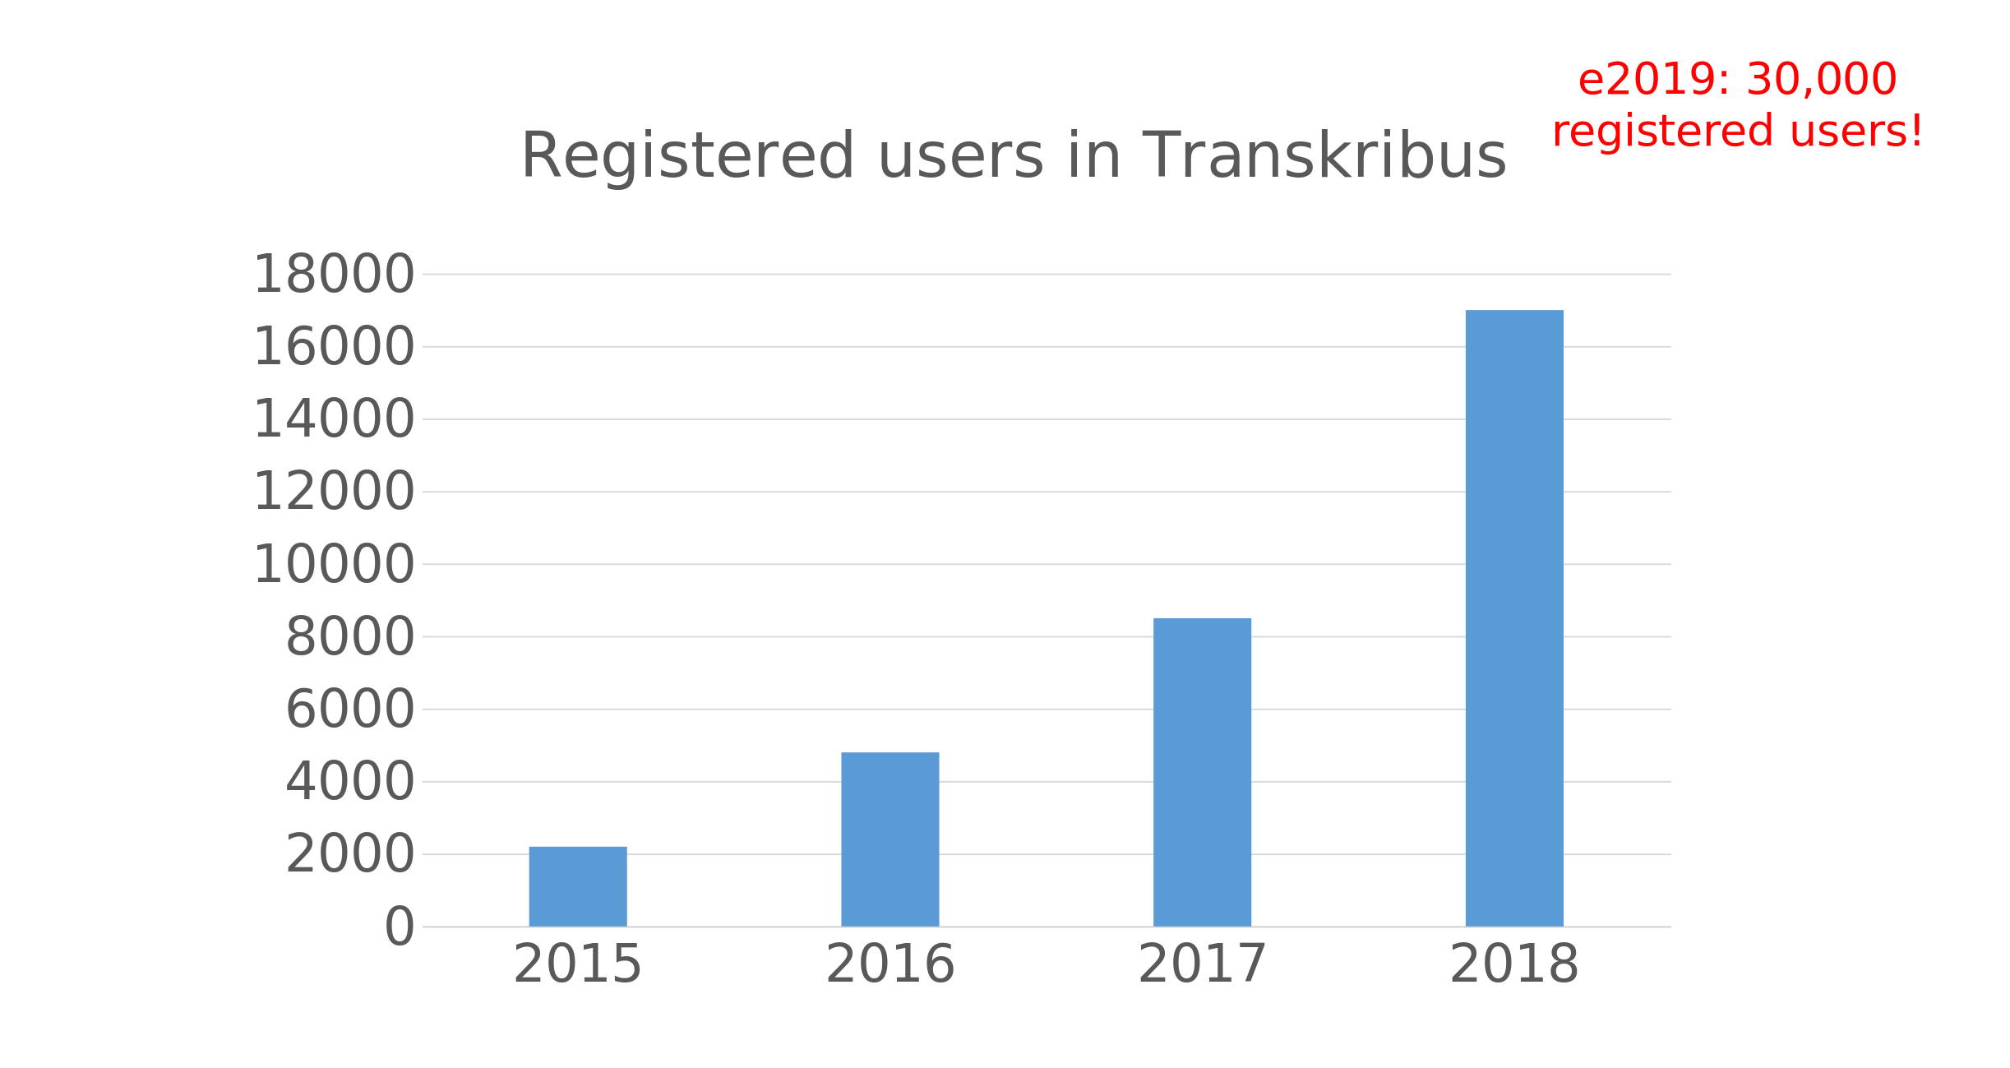
Chart taken from meuhlberger_transkribus_HPX.pptx

Slide 20
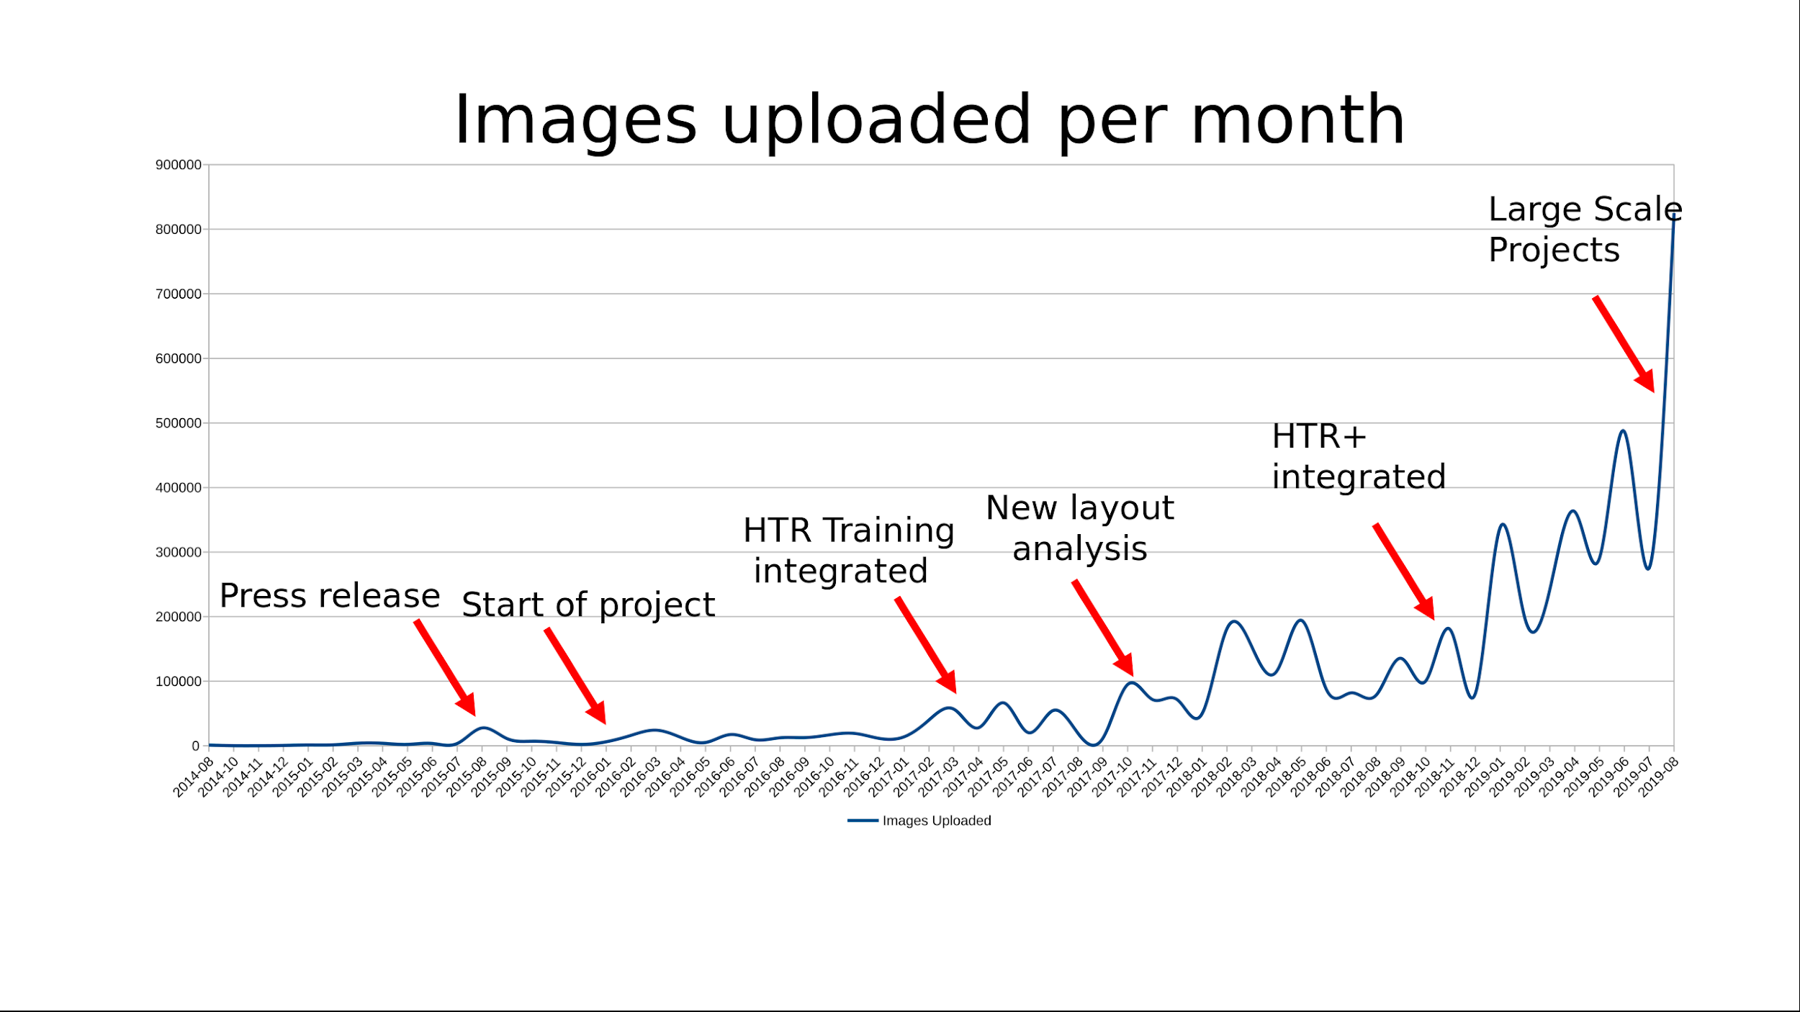
Chart taken from meuhlberger_transkribus_HPX.pptx

Slide 21
how does it work?
two main components
Server
Client

Slide 22
how does it work? - Server
Data storage
user-data
images
metadata
layout/text data
PAGE/XML
Data processing
Layout Analysis
Text Recognition
Format conversions

Slide 23
Hardware
HP Bladecenter c7000
16x BL460c G7 2x 6C L5640 2,26GHz 48GB 600GB 6G
2 Intel Dual Xeon GPU-Server
24 CPU cores, 188 GB RAM & 8 graphicsprocessing units (GPU) each
Used for GPU heavy tasks like HTR-Training
LEO4 – SGE computing cluster at the University of Innsbruck
48 nodes with 28 Intel Xeon cores, 64GB RAM for each node
Used for HTR of large dataset
Storage
Ca. 20 TB on a Transkribus file share at the ZID

Slide 24
Performance
HP BladeCentre / GPU servers
Jobs are written into database, worker modules process jobs according to simple scheduling configuration
Recognition runs on CPUs
Training of Tensorflow and PyTorch models runs on GPUs
HTR and LA recognition
Ca. 30-120’’ per image
5 Blades, per blade about 5000 images per day
New implementation will allow speed up of factor 5-10
Training
Depends strongly on amount of data and number of epochs
Small datasets (e.g. 100-200 images, 200 epochs) can be processed in 3-5h
Larger datasets with e.g. 2000-3000 images and 2000 epochs need 5-7d
If we want to process really large datasets (tens-of-thousands of images) we run into a resource problem!

Slide 25
how does it work? - Client: Transkribus GUI
user needs to download client https://transkribus.eu/Transkribus/
runs on local (user’s) work station
provides communication interface to server
upload, process (jobs), download
provides interface(s) for
creating/editing/deleting
collections
documents
transcribing
annotating
text
layout

Slide 26
how does it work? - Hands on
upload images
run layout analysis
correct layout analysis
run HTR
sync local text files with doc (Text2Image)
compare model
import different model from another collection
run HTR again
export document

Slide 27
why and when to use Transkribus
when you have images/facsimiles (obviously)
to many text to process ‘by hand’
want to work collaboratively
no other means to ‘publish’ your work
best suitable for big amount of texts
Finnish Court Records
https://transkribus.eu/r/kansallisarkisto/en

Slide 28
European Cooperative Society (SCE)
Cooperative
Enables collaboration of independent institutions which want to reach a common goal
Distributed ownership and sharing of data in the focus
Main features of an SCE
Open for new members, low barriers: 1000 EUR share as minimum
Membership share for natural persons EUR 250
Democratic constitution: Board of Directors – General meeting
Direct benefit for members – no shareholder value
Customers become owners, owners become customers
Subscription fees and service based fees for professional usage
Free for everyone up to 1000 pages
https://read.transkribus.eu/coop/

Slide 29
Transkribus the “Datenschleuder”
include Data (images, texts, indices) in custom applications
https://schnitzler-zeitungen.acdh-dev.oeaw.ac.at/ (work in progress)
https://rita-vfbr.acdh-dev.oeaw.ac.at/ (restricted acces due to open legal questions)
https://gtrans.acdh.oeaw.ac.at/

Slide 30
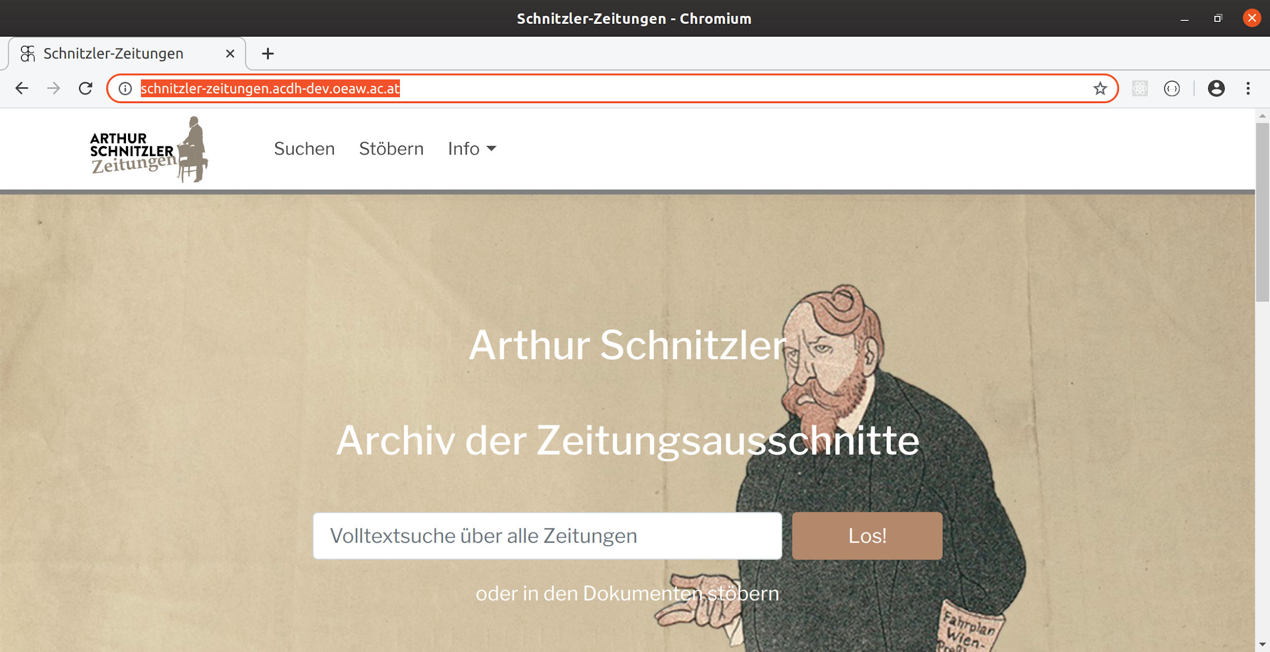
https://schnitzler-zeitungen.acdh-dev.oeaw.ac.at/

Slide 31
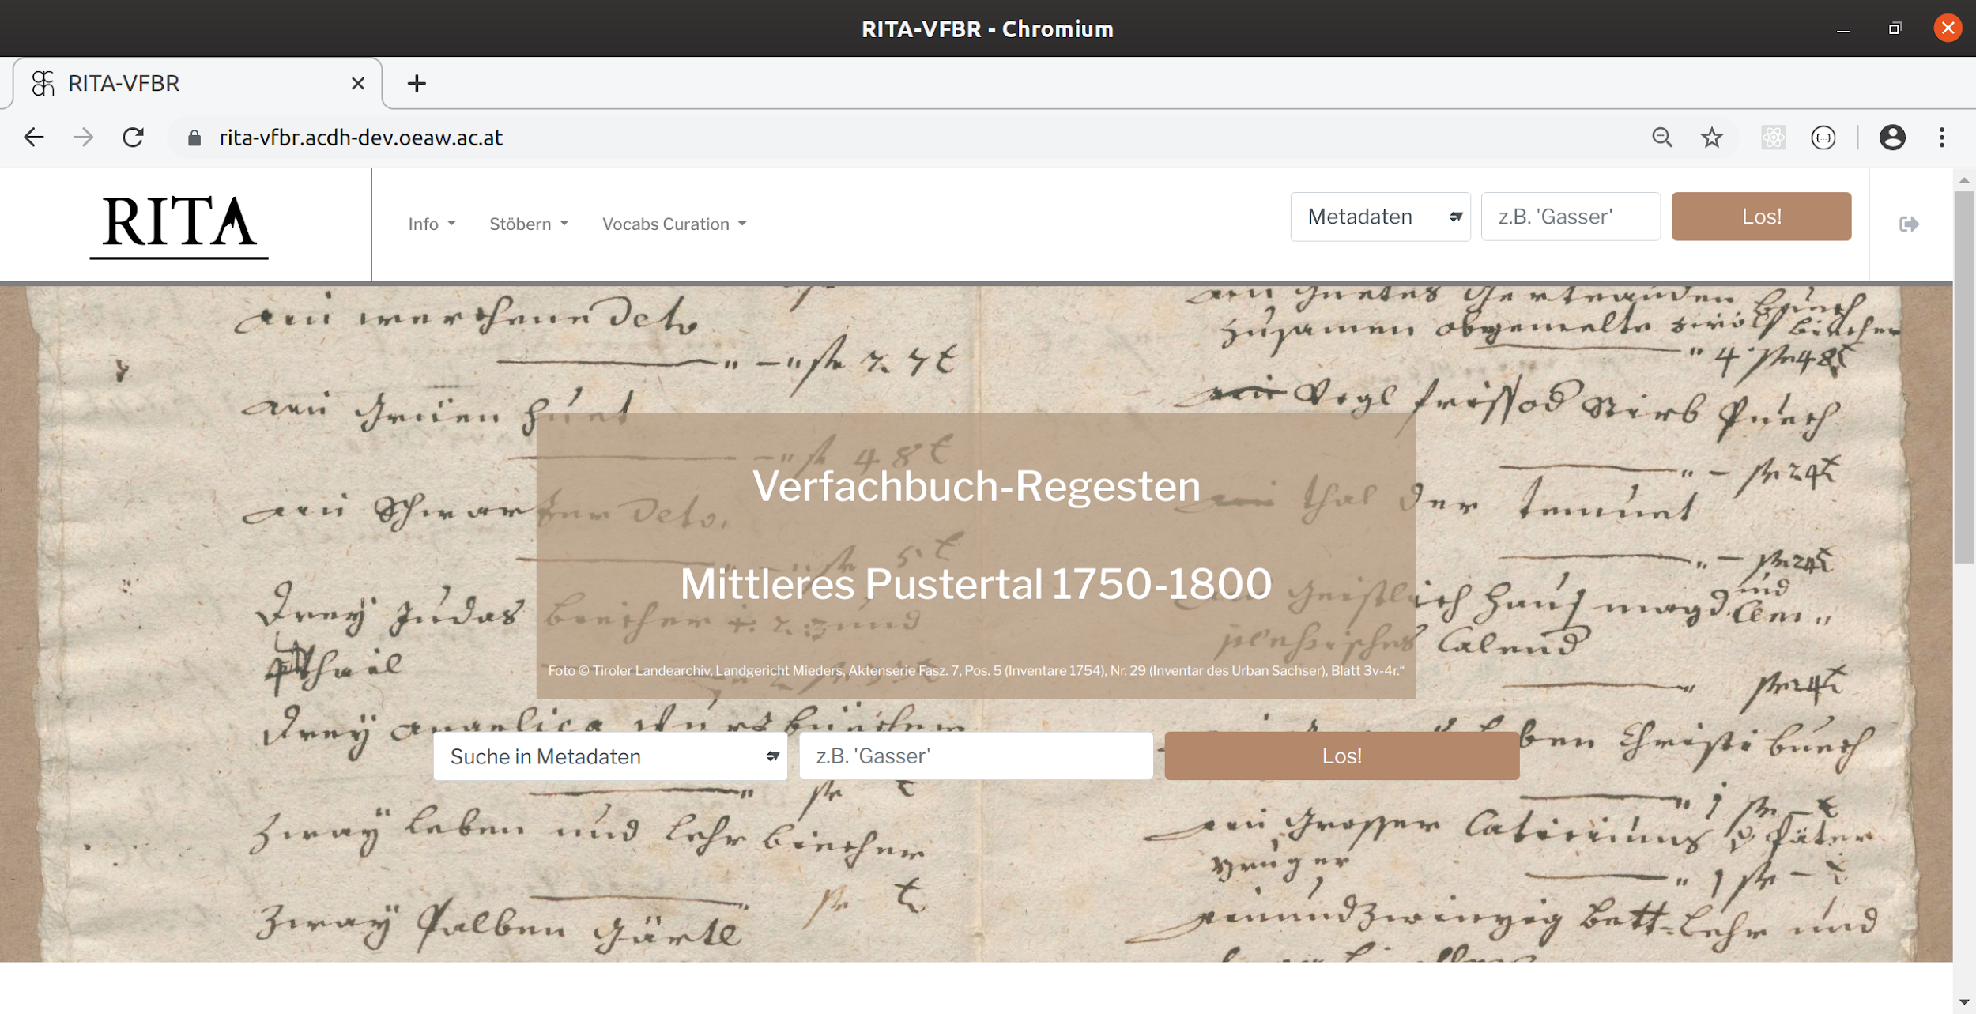
https://rita-vfbr.acdh-dev.oeaw.ac.at/

Slide 32
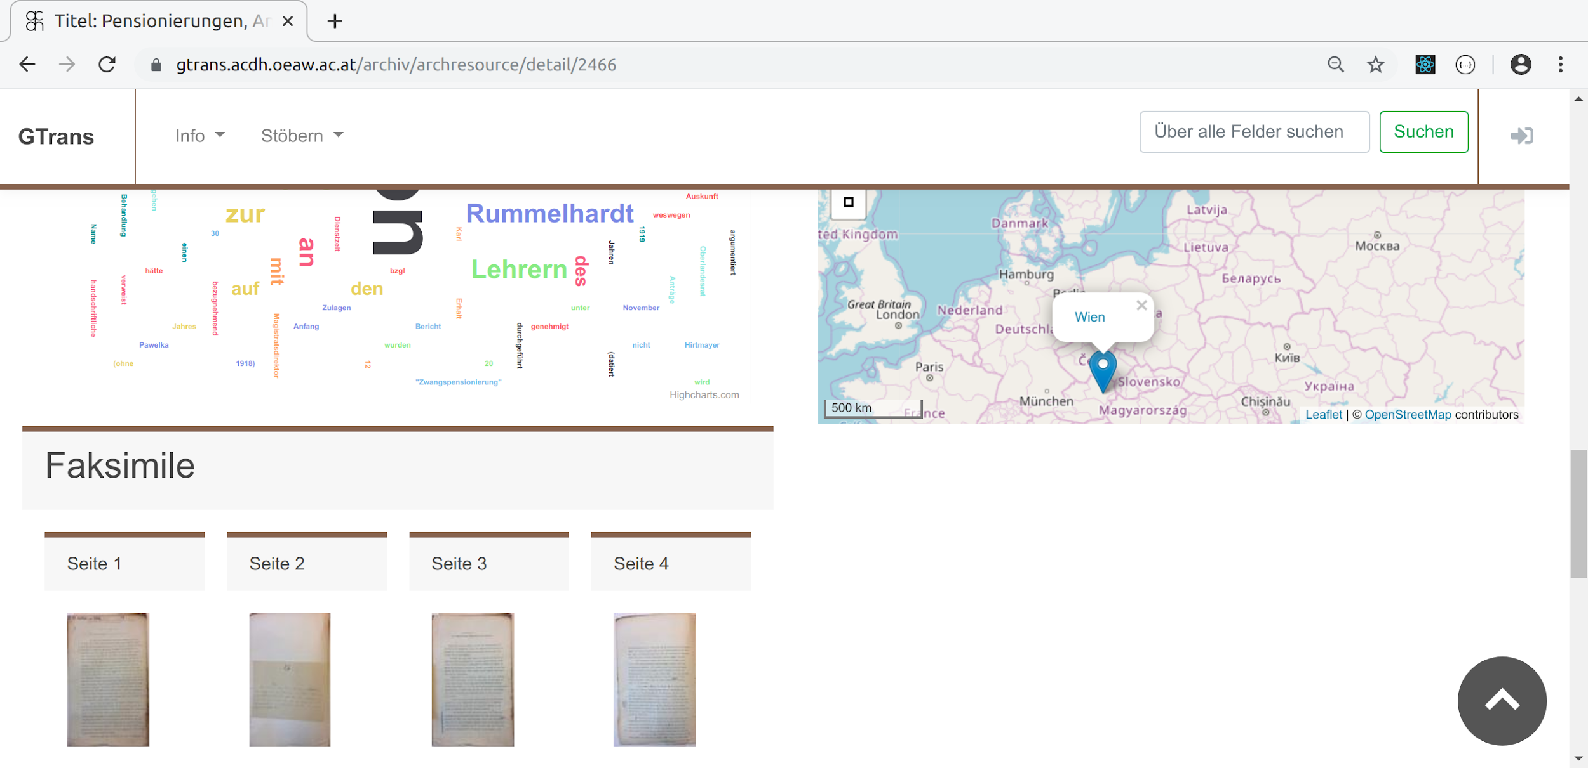
https://gtrans.acdh.oeaw.ac.at/archiv/archresource/detail/2466

Slide 33
Transkribus the “Datenschleuder”
include Data (images, fulltexts, indices) in custom applications
https://schnitzler-zeitungen.acdh-dev.oeaw.ac.at/ (work in progress)
https://rita-vfbr.acdh-dev.oeaw.ac.at/ (restricted acces due to open legal questions)
https://gtrans.acdh.oeaw.ac.at/
stream Data (images, texts) into tools/applications like https://prodi.gy/
https://prodigy-mpr-textcat.herkules.arz.oeaw.ac.at/ (not public, restricted by IP)
train a spaCy text classification model to detect paragraphs, footnotes, headers, page-numbers, ….

Slide 34
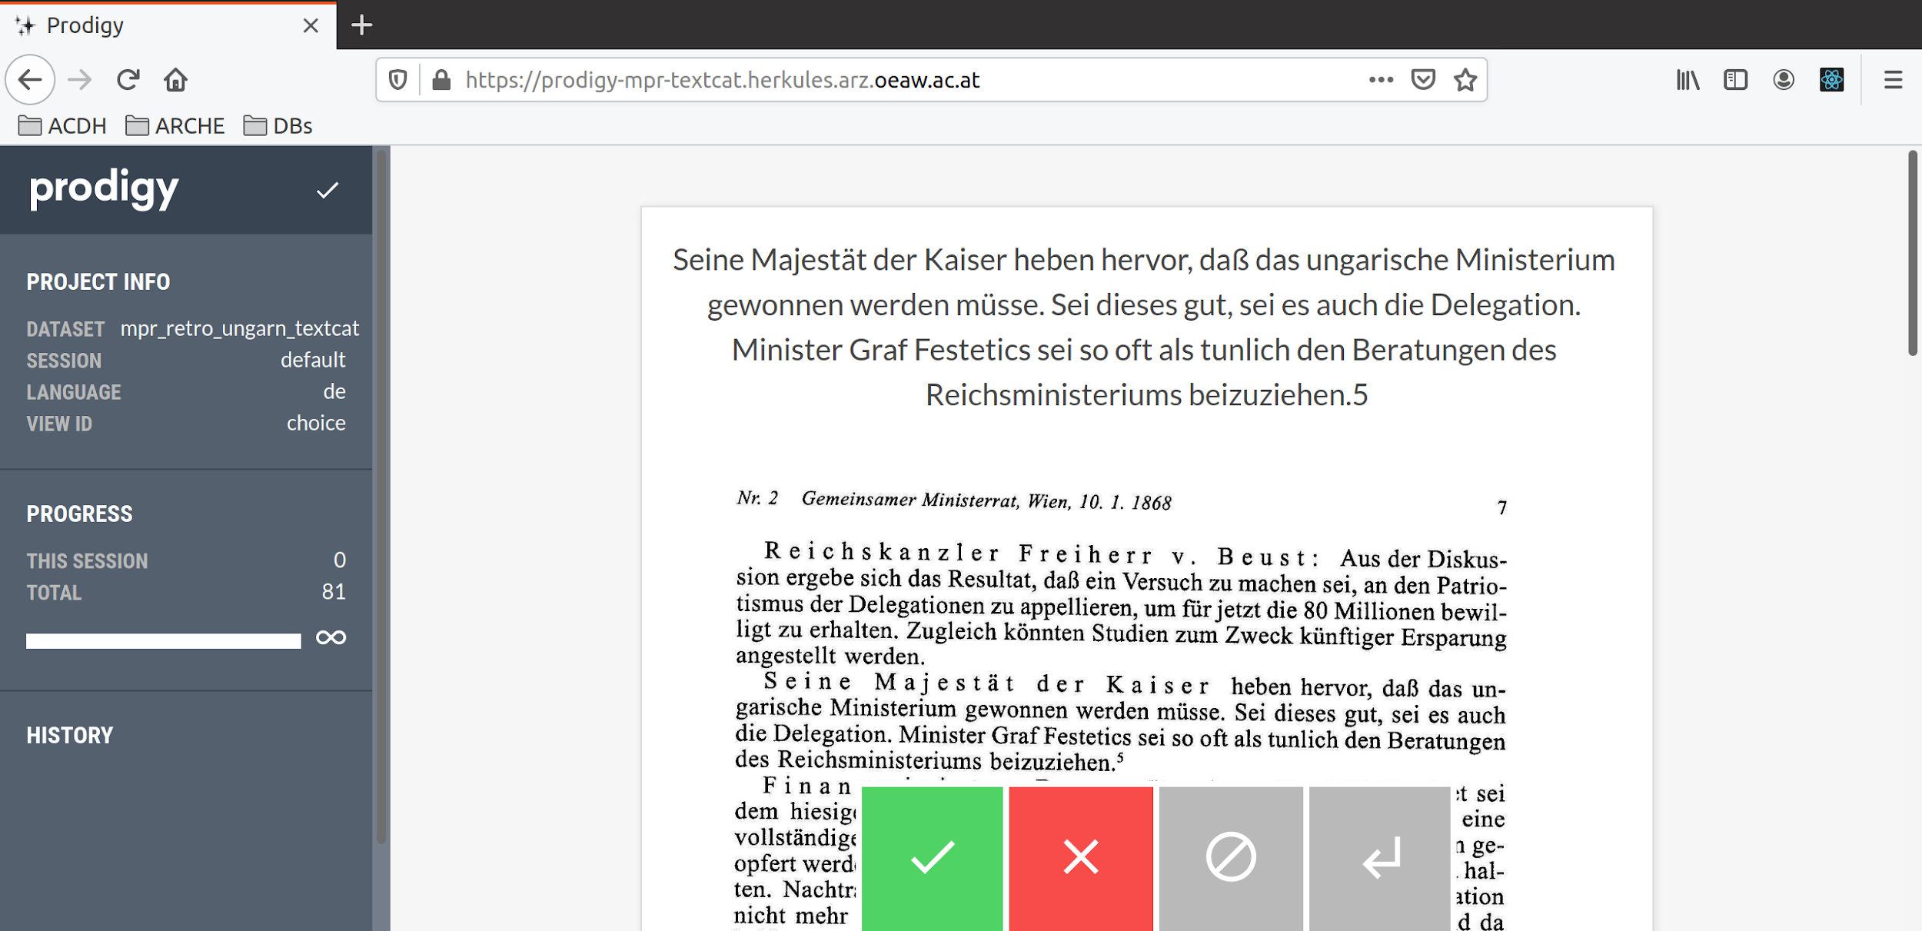
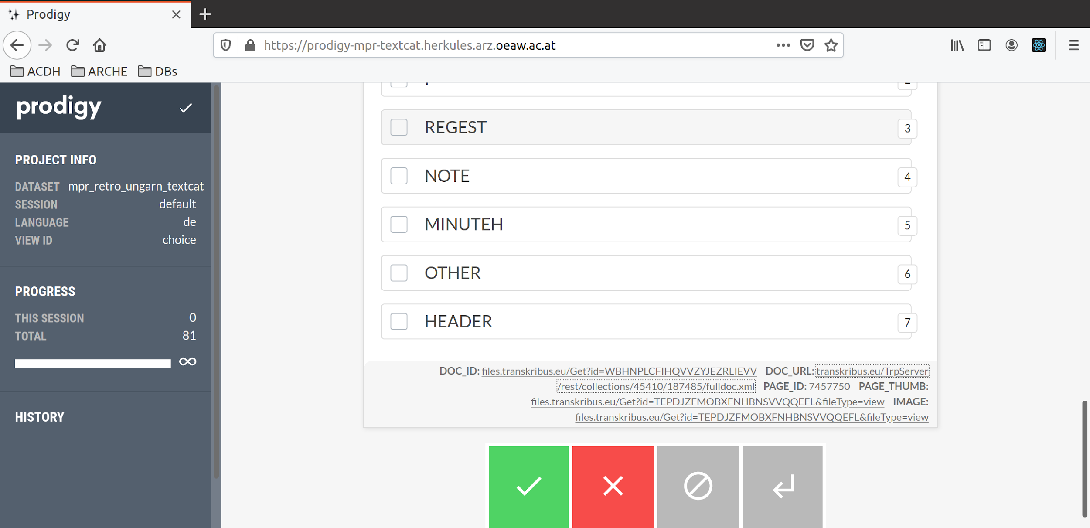
https://prodigy-mpr-textcat.herkules.arz.oeaw.ac.at/

Slide 35
Transkribus Data enrichment/conversion tool
PDF -> Digital Edition (TEI)
import an digitized printed edition into Transkribus
run Layout Detection + OCR

Slide 36
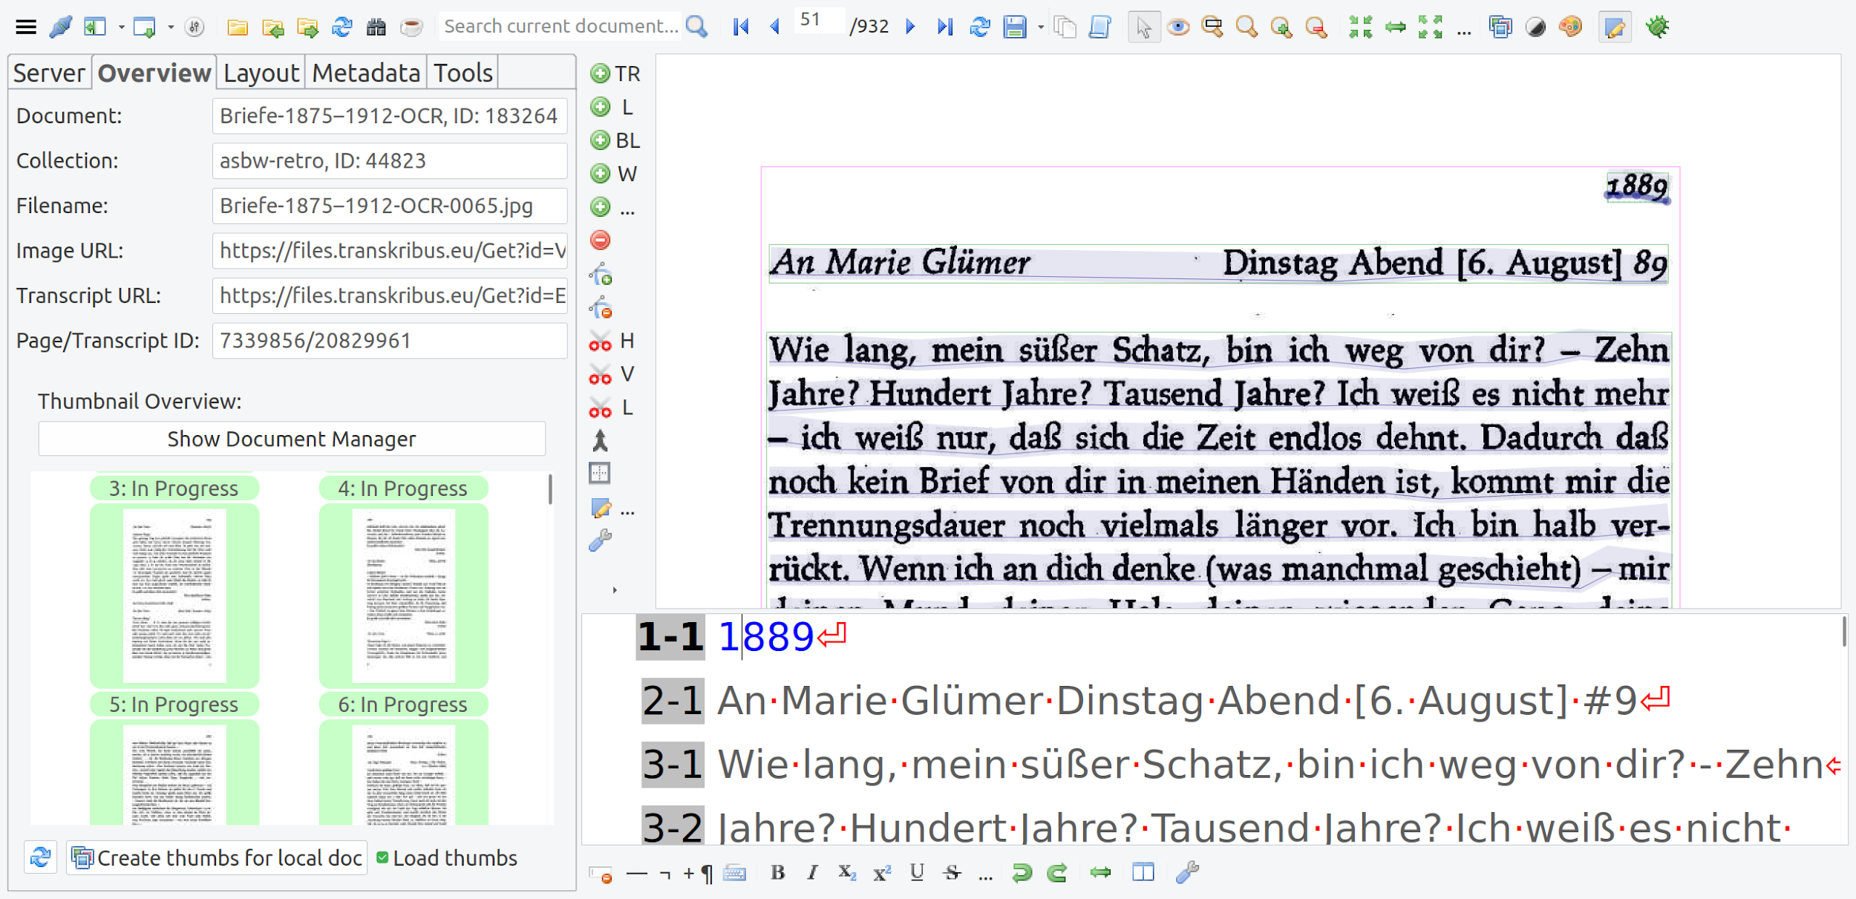
the no manual work digital edition

Slide 37
Transkribus Data enrichment/conversion tool
PDF -> Digital Edition (TEI)
import an digitized printed edition into Transkribus
run Layout Detection + OCR
export as TEI
runs some custom post processing scripts
split document into single files per letter
add metadata
runs some custom NER script
upload data into a digital edition framework (dsebaseapp)

Slide 38
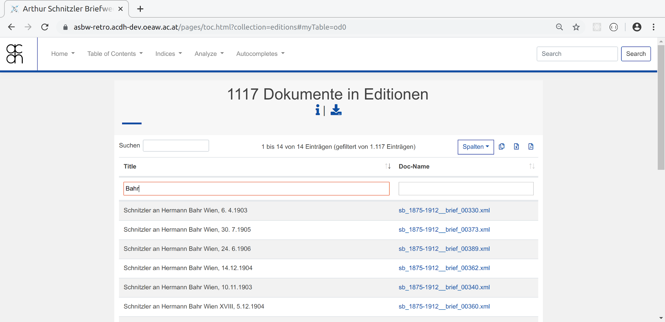
https://asbw-retro.acdh-dev.oeaw.ac.at/ (play project)

Slide 39
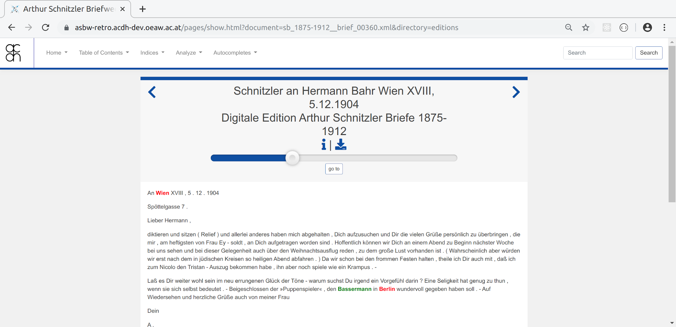
https://asbw-retro.acdh-dev.oeaw.ac.at/pages/show.html?document=sb_1875-1912__brief_00360.xml&directory=editions

Slide 40
some links
https://github.com/KONDE-AT/dsebaseapp
https://github.com/acdh-oeaw/acdh-prodigy-utils
https://github.com/acdh-oeaw/acdh-django-transkribus
https://transkribus.eu/wiki/index.php/REST_Interface
https://github.com/transkribus/
https://github.com/Transkribus/TranskribusPyClient
https://github.com/Transkribus/TranskribusDU

